Slide 1
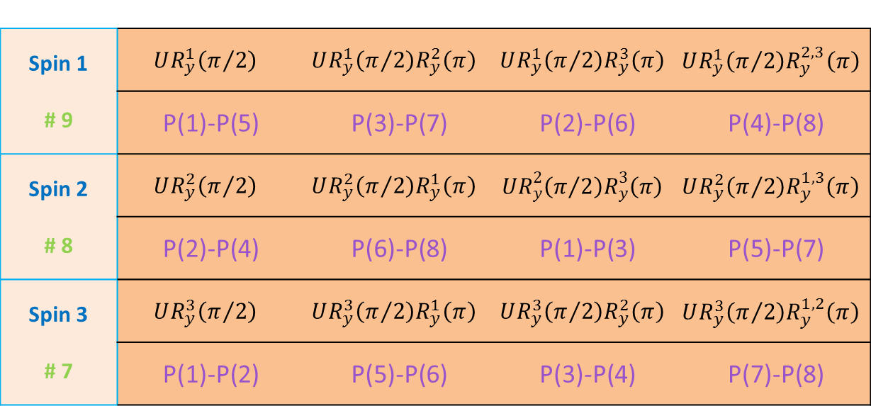
Spin 1 # 9 | $$UR_{y}^{1}\left(π/2\right)$$ | $$UR_{y}^{1}\left(π/2\right)R_{y}^{2}\left(π\right)$$ | $$UR_{y}^{1}\left(π/2\right)R_{y}^{3}\left(π\right)$$ | $$UR_{y}^{1}\left(π/2\right)R_{y}^{2,3}\left(π\right)$$
 | P(1)-P(5) | P(3)-P(7) | P(2)-P(6) | P(4)-P(8)
Spin 2 # 8 | $$UR_{y}^{2}\left(π/2\right)$$ | $$UR_{y}^{2}\left(π/2\right)R_{y}^{1}\left(π\right)$$ | $$UR_{y}^{2}\left(π/2\right)R_{y}^{3}\left(π\right)$$ | $$UR_{y}^{2}\left(π/2\right)R_{y}^{1,3}\left(π\right)$$
 | P(2)-P(4) | P(6)-P(8) | P(1)-P(3) | P(5)-P(7)
Spin 3 # 7 | $$UR_{y}^{3}\left(π/2\right)$$ | $$UR_{y}^{3}\left(π/2\right)R_{y}^{1}\left(π\right)$$ | $$UR_{y}^{3}\left(π/2\right)R_{y}^{2}\left(π\right)$$ | $$UR_{y}^{3}\left(π/2\right)R_{y}^{1,2}\left(π\right)$$
 | P(1)-P(2) | P(5)-P(6) | P(3)-P(4) | P(7)-P(8)

